Slide 1
New GSKY Client Software Apps
Exploring client apps other than TerriaMap
Copyright © 2019 by National Computational Infrastructure, Canberra, ACT, Australia. All Rights Reserved.
Author: Arapaut V. Sivaprasad.
11 March, 2018

Slide 2
Objectives
TerriaMap is the only tested client for GSKY
Less known to the wide world
Explore how GSKY can be used with other clients
Create examples and tutorials
Implement a DAP service in GSKY
Next: Potential GSKY Clients

Slide 3
Potential GSKY Clients
Application | Comments | GSKY
ArcGIS | Most widely used GIS software | Works on 4 out of 6 App veriants
QGIS | Widely used and VDI-integrated | Works on v3.4
AUSGIN | Australian Geoscience Information Network | Works on Production GSKY server
NASA World View | Not directly suitable for GSKY | No WMS layer addition facility
NASA World Wind | Do. | Do.
Google Earth | Very popular software | WMS facility does not work
Auscope | Parallel service to AusGIN | Works on Production GSKY server
Next: Potential Clients Described

Slide 4

Potential Clients Described
Claimed to be “the world's most powerful mapping and analytics software”
Commercial app from Environmental Systems Research Institute (ESRI)
Six different apps in the suite.
All except one are Windows’ apps.
ArcGIS Pro
Most comprehensive app in the suite.
Works well with GSKY.
ArcGIS Online
Online version of ArcGIS Pro.
Not as comprehensive as the desktop version.
Works well with GSKY on production server.
ArcGIS Earth
Relatively simpler to learn.
Alternative to Google Earth for corporate users.
Works with GSKY but has errors.
Next: Other ArcGIS Apps

Slide 5
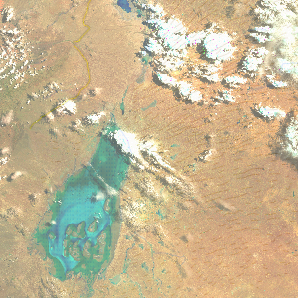
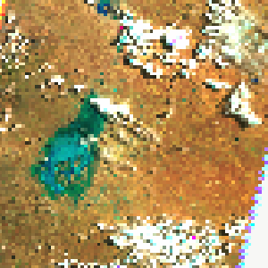
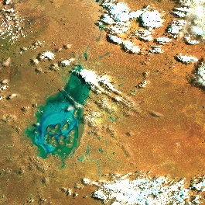
Other ArcGIS Apps
These are similar software and share the data between them.
Only ArcMAP is working with GSKY.
ArcMap
No-frills app within the ArcGIS suite
Works well with GSKY
Low picture quality
ArcGlobe
TerriaMap
ArcMap
3D base map.
Does not add the GSKY layer
Maybe fixable
ArcScene
No base map (?!)
Does not add the GSKY layer
Maybe fixable
Next: ArcGIS Alternatives
ArcMap – small canvas

Slide 6
ArcGIS Alternatives
There are several free alternatives to ArcGIS.^{[Ref]}
Not explored
Probably low user base
GRASS
Developed under US Govt grant in 1982
Python console
uDIG
Public domain program
gvSIG
Public domain program
Next: ArcGIS Pro Desktop

Slide 7
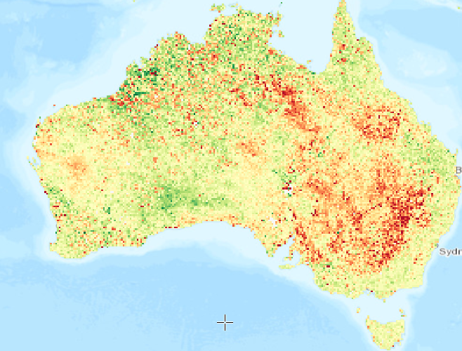
ArcGIS Pro Desktop App
ArcGIS Pro
Tutorial: https://github.com/.../ArcGIS_Pro_Desktop_Tutorial.pptx
Installation, activation and configuration.
Add GSKY Web Map Service.
Advanced use of ArcGIS Pro using an example.
Dozens of free public domain layers and base maps.
e.g. Natural water layer, buildings, roads, forests, MacDonalds!
Attribute tables and many analysis methods.
Python console and built-in tools.
Easier to escape from a hurricane than learning this software fully.
Next: ArcGIS Online

Slide 8
ArcGIS Online
ArcGIS Online
Tutorial: https://github.com/.../ArcGIS_Online_Tutorial.pptx
Requires an ArcGIS Online account (ANU Institutional Licence)
It has many features of ArcGIS Pro and is platform independent.
Simple Use:
Create a map
Add a layer
Set map for share
Advanced Use:
Add demographic data
Style the layer with attribute data
Normalise the style data
Customise the Pop-up
Create a web App and share its URL
Add GSKY Web Map Service…
Works well with GSKY on production server.
Next: ArcGIS Earth

Slide 9

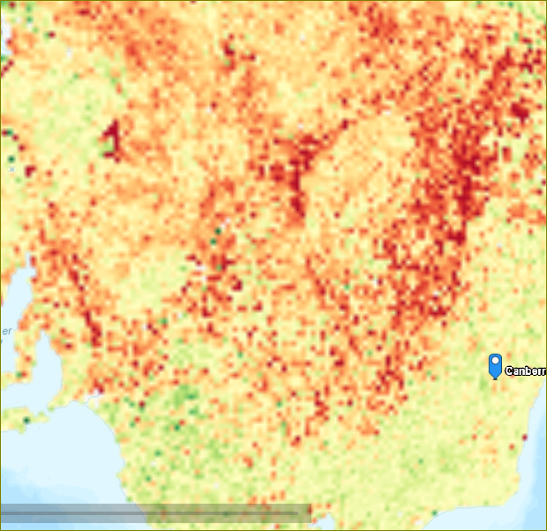
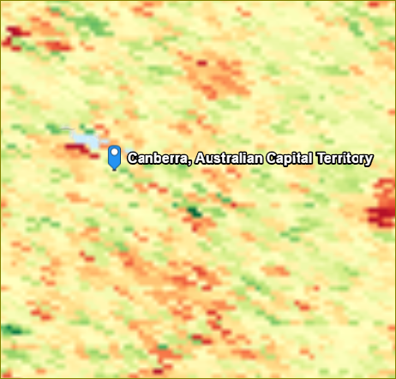
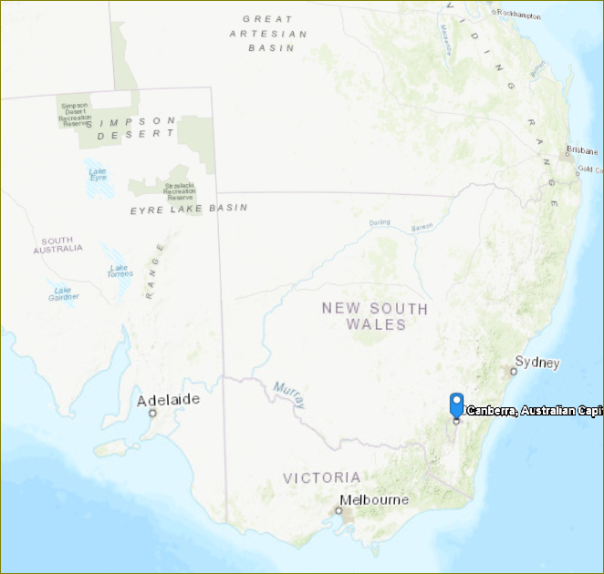
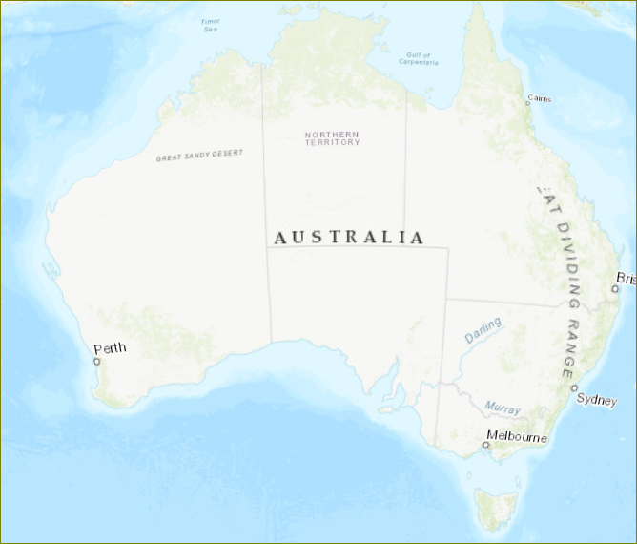
ArcGIS Earth
ArcGIS Earth
Tutorial: https://github.com/…/ArcGIS_Earth_Tutorial.pptx
Requires an ArcGIS Desktop Advanced Licence.
Requires additional step to install.
Windows desktop only.
Much simpler to use than others.
Alternative to Google Earth.
Add GSKY Web Map Service…
Works with GSKY but goes blank at lower zoom levels.
The layer disappears. It is probably due to wrong bounding box values returned by ArcGIS Earth.
Next: Google Earth

Slide 10

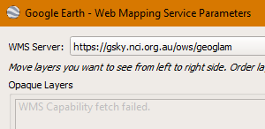
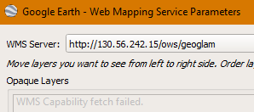
Google Earth
Google Earth
Tutorial: Not yet done.
Free software from Google.
Very widely used.
Has WMS capability.
Not connecting to GSKY servers yet.
query: map[service:[WMS] version:[1.1.1] request:[GetCapabilities]]
Next: QGIS

Slide 11


QGIS
QGIS
Tutorial: https://github.com/.../QGIS_Desktop_Tutorial.pptx
Free and open source program.
Windows, Mac and VDI versions.
About as complex as ArcGIS Pro.
Large number of options and settings.
Add GSKY Web Map Service…
Works well with GSKY.
Only the latest version, 3.4.x, works with GSKY.
Next: AusGIN

Slide 12
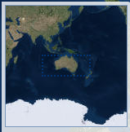

AusGIN
AUSGIN
Tutorial: Not yet done.
Free and web based service.
Provided by Geoscience and various Australian state governments.
Pre-made layers.
Facility to add own layers.
WMS layer facility.
Add GSKY Web Map Service…
Works well with GSKY on production server.
Next: Auscope

Slide 13
Auscope
Auscope
Tutorial: Not yet done.
Free and web based service.
Based in Uni of Melbourne and funded by Comm Govt.
Pre-made layers.
Facility to add own layers.
WMS layer facility.
Add GSKY Web Map Service…
Works well with GSKY on production server.
Next: NASA World Wind

Slide 14


NASA World Wind
World Wind
Tutorial: Not done.
Free and open source program.
Maps and layers provided by various organisations.
Build your own 3D globe application from the SDK.
Make and publish your map on World Wind servers.
World Wind project will be suspended from April 5, 2019.
Adding GSKY Web Map Service…
May have to ask NASA to publish our data.
Next: NASA World View

Slide 15
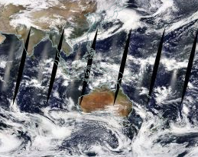

NASA World View
World View
Tutorial: Not done.
Free online service.
Maps and layers provided by various urganisations.
Online service to publish maps and layers.
Make and publish your map on World View servers.
Adding GSKY Web Map Service…
No facility to add external WMS service.
Services and layers are pre-published.
Next: DAP Service in GSKY

Slide 16

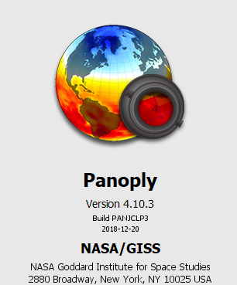

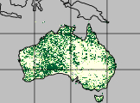
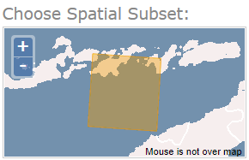
DAP Service in GSKY
GSKY can aggregate NetCDF files
DAP can deliver them to other software for analyses
So, let us combine the two features !
First step:
Create an aggregate output file in NetCDF format
Open it in Panoply or Python Notebook - OK
Next: Provide as NetCDF subset service
APIs to connect directly to GSKY
Send the data in DAP format
Still learning !
End of Slides

Slide 17






Acknowledgements

